Slide 1
TIMESERIES- COMMODITY PROBLEM
Moderated by:
Mr Srikar Muppidi
Presented by:
Kevin Rajkumar
Sukalp Shivam
Manas Ghosh
Gaurav Garhewal

Slide 2
objective
The objective is to study the monthly trend of most important commodities and then forecast for the next 12 months in each region of India.

Slide 3
Dataset description
Date
Centre
Regions
Commodity
Price per kg
Country
The date on which that particular observation has been taken
Contains the city from which the observation has been taken
Centres converges in five regions
Describes the product we are observing
Contains the price of individual product from particular center on particular date
Contains country name

Slide 4
Background
The dataset contains retail prices for key commodities recorded around 75 key market centres in India.
The granularity of the dataset is at day level.
The country is divided into 5 regions i.e. (North, South, East, West, North-East) and each region has different a centre.
The dataset contains the Prices/rates of commodities of different regions with respect to time which is from 1997 to 2015.
The dataset has 9 commodities i.e. (Onion, Rice, Tea Loose, Tur/Arhar Dal, Sugar, Salt Pack, Milk, Tomato, Sunflower oil) and for each commodity we have prices per kg.
The dataset is talking about the trend of each commodity which is increasing and decreasing according to the data. So, we are basically analysing the trend of each commodity with respect to time and will forecast the trend for next 12 months.

Slide 5
Factors affecting commodity pricing
Production related
Global Inflation
Less space for cultivation
Costs involved in storage
Seasonality
Increased cost of transportation
Supply chain mismanagement
Economic and political environment which manifest itself in the form of trade constraints, subsidies, taxes etc
Increase in the price of goods and services in the market
With less availability of land, the prices for agricultural land are rising, leading to increased costs of agriculture produce.
The cost involved in physically storing the commodities
Include weather related patterns, operational risk, climatic conditions
Increase in fuel price increases transportation cost
From farmer to consumer

Slide 6
MISSING VALUE treatment
Data without trend and seasonality
Mean, median, mode, random sample imputation
Data with trend and without seasonality
Linear interpolation
Data with trend and seasonality
Seasonal adjustment + interpolation

Slide 7
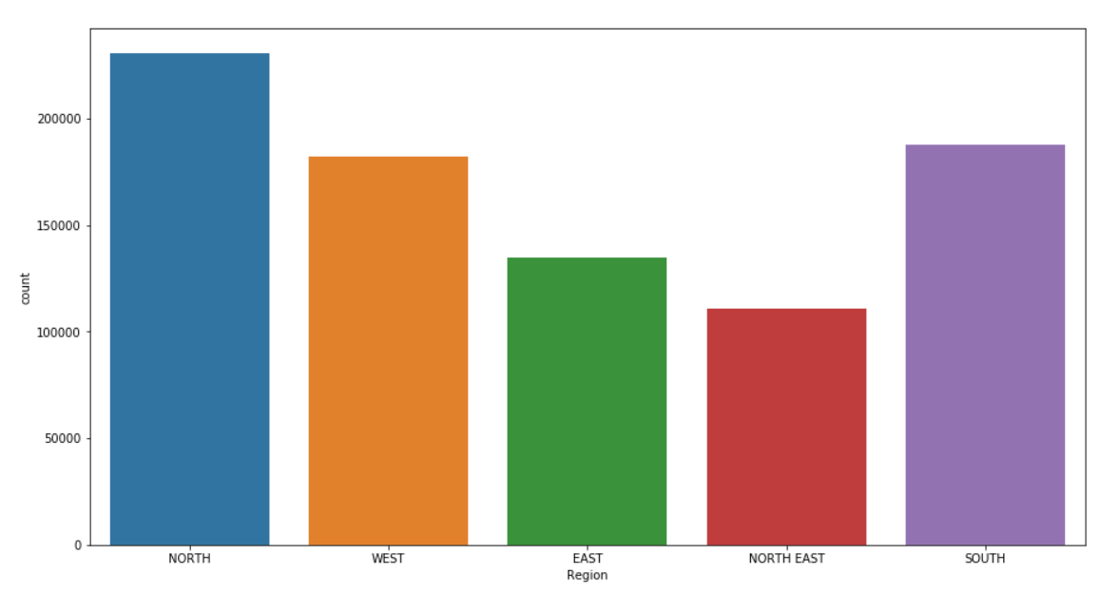
Region-wise commodities

Slide 8
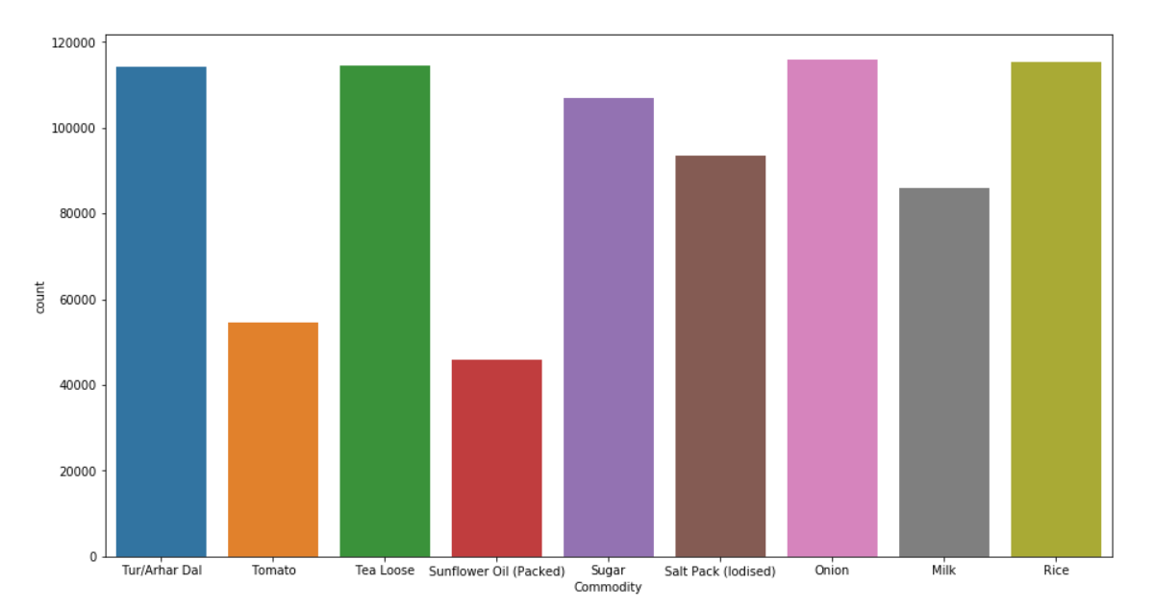
Commodities across regions

Slide 9
Feature engineering
Load the dataset into a variable
Extract date info from the date feature of the dataset
Use this date, to create new feature called Time index
Pick region and commodity to do analysis
Create new data frame for the analysis containing only required region and commodity
Extract month-year from this Time index
Use group by function to level the data frame to the monthly level
Create month and year features in the data frame by extracting them from time index for further analysis

Slide 10
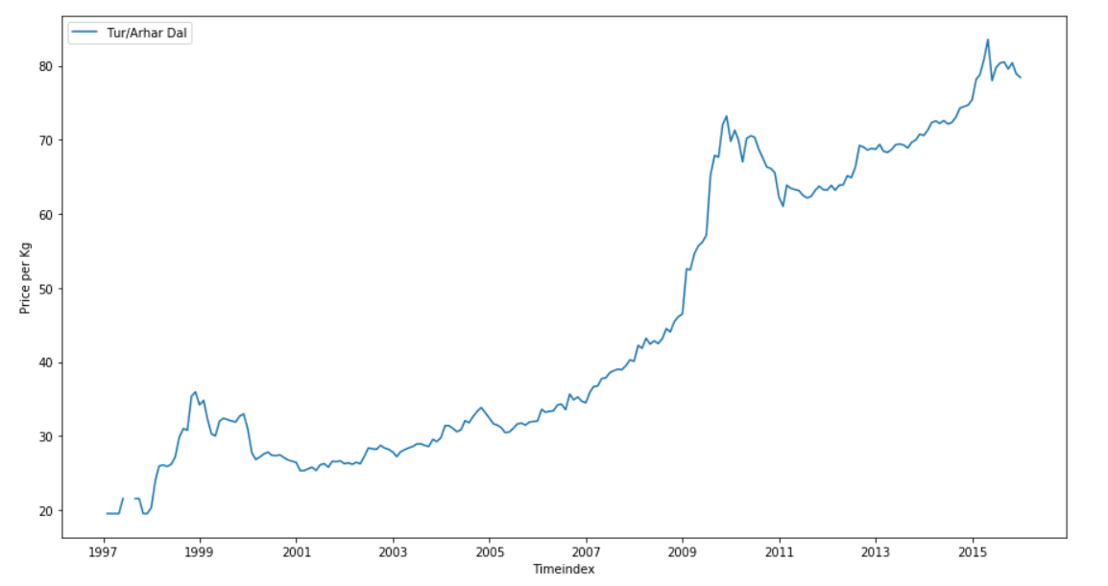
Trend- north region- with null

Slide 11
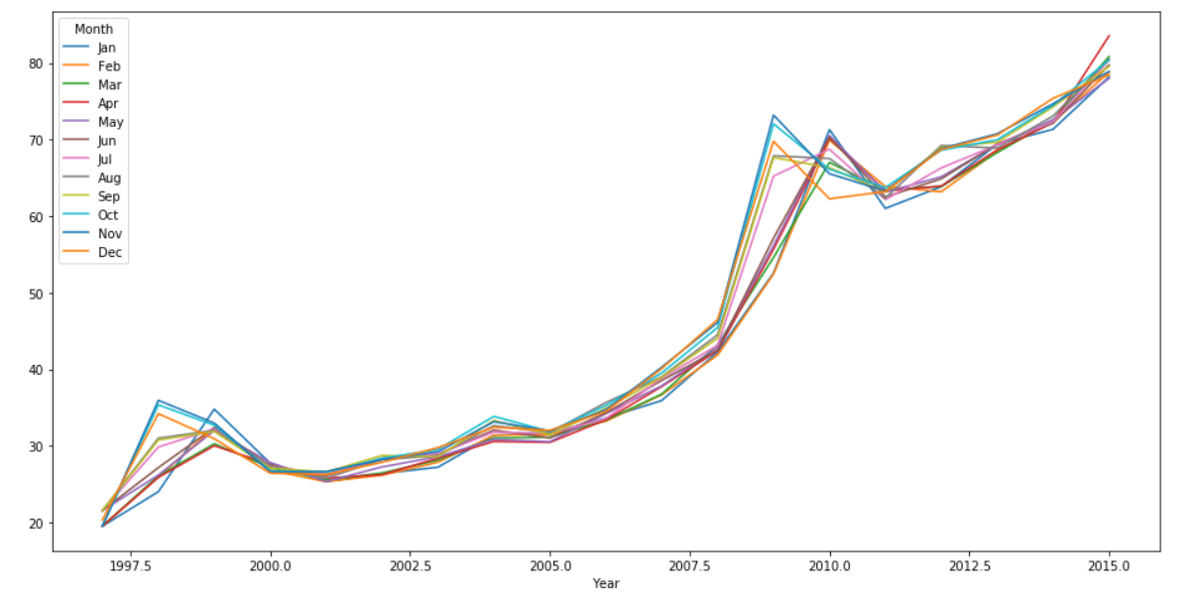
seasonality

Slide 12
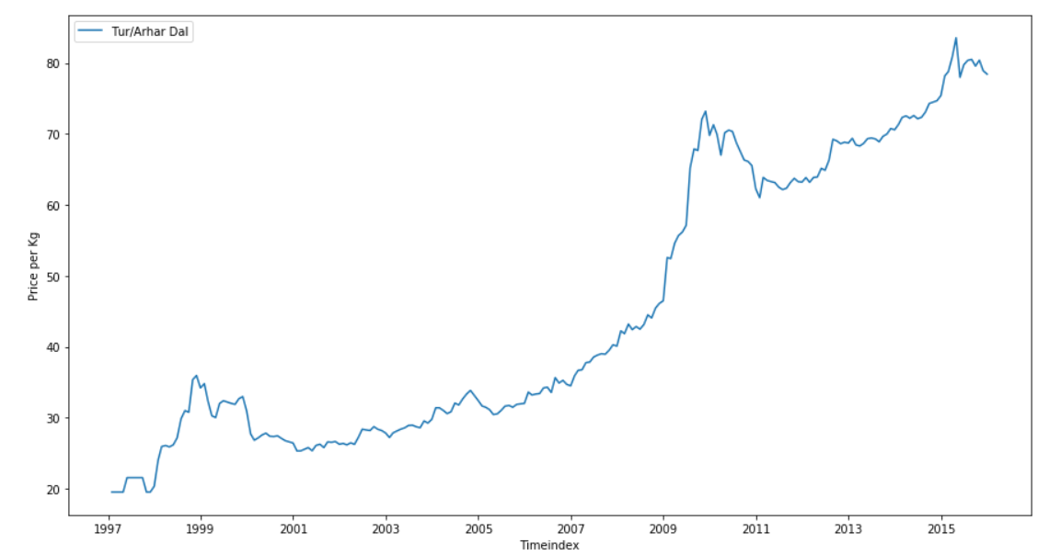
Trend- north region

Slide 13
Model techniques
Timeseries Modelling
Decomposition
Simple Exponential Smoothing
Holts Model
Regression (auto)
ARIMA model
Holts-Winter Model
SARIMA model

Slide 14
Thank you

